Slide 1
Continuous Integration

Slide 2
What is CI?
Continuous Integration is the stage where the code supporting new functionality is integrated with the existing code. Since there is continuous development of software, the updated code needs to be integrated continuously as well as smoothly with the systems to reflect changes to the end users. The changed code, should also ensure that there are no errors in the runtime environment, allowing us to test the changes and check how it reacts with other changes. Jenkins is a very popular tool used for Continuous Integration. Using Jenkins one can pull the latest code revision from GIT repository and produce a build which can finally be deployed to test or production server. It can be set to trigger a new build automatically as soon as there is change in the GIT repository or can be triggered manually on click of a button.

Slide 3
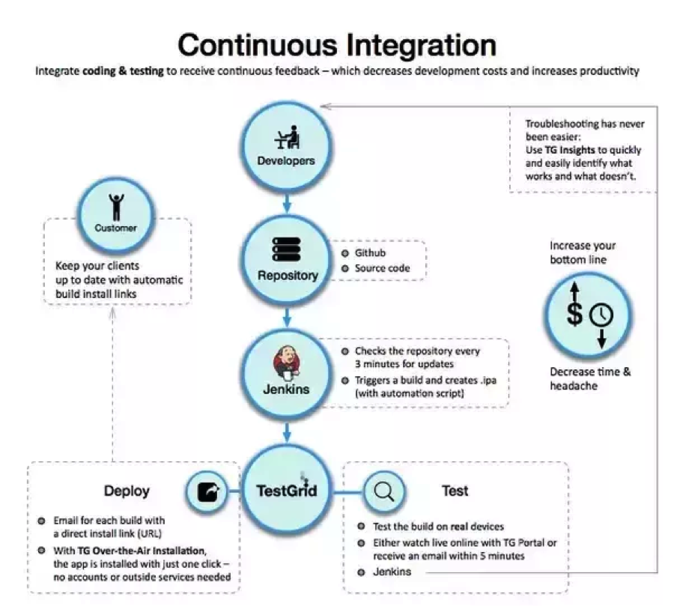
Importance of CI

Slide 4
What is Jenkins?
Jenkins is a self-contained, open source automation server which can be used to automate all sorts of tasks such as building, testing, and deploying software. Jenkins can be installed through native system packages, Docker, or even run standalone by any machine with the Java Runtime Environment installed.

Slide 5
Benefits of Jenkins
Java application
Platform independent
Open-source
Build pipeline
2000 + plugins

Slide 6
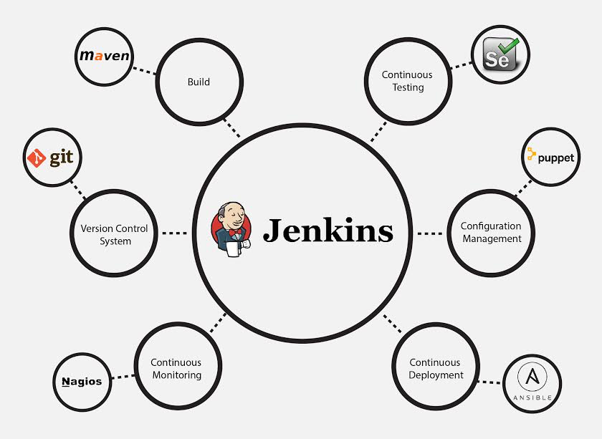
Jenkins supports

Slide 7
Installing Jenkins
Java:
>> sudo yum install java-1.8.0-openjdk
>> java -version

Slide 8
Install TomCat9
Install Apache Tomcat 9:
>> sudo yum install wget
http://www-eu.apache.org/dist/tomcat/tomcat-9/v9.0.0.M21/bin/apache-tomcat-9.0.0.M21.tar.gz
>> chmod 755 apache-tomat-9.0.0.M21.tar.gz
tar xzf apache-tomat-9.0.0.M21.tar.gz

Slide 9
Configure Tomcat9
>> vi /home/kkavuri/tomcat9/conf/tomcat-users.xml
<?xml version="1.0" encoding="UTF-8?>
<tomcat-users>
<pre><role rolename="manager-gui"/>
<role rolename="manager-script"/>
<role rolename="manager-jmx"/>
<role rolename="manager-status"/>
<role rolename="admin-gui"/>
<role rolename="admin-script"/>
<user username="kkavuri" password="xxxxx" roles="manager-gui,manager-<wbr />script,manager-jmx,manager-<wbr />status,admin-gui,admin-script"<wbr />/>
</tomcat-users>
>> cd tomcat9
>> ./bin/startup.sh

Slide 10
download Jenkins
download Jenkins war file:
>> cd
>> wget http://updates.jenkins-ci.org/download/war/2.7.3/jenkins.war

Slide 11
Jenkins war
Deploy Jenkins war File:
copy the Jenkins.war file in ~/tomcat9/webapps folder
open your browser and access localhost:8080
click on the Manager App
Enter your username and password

Slide 12
Standalone Jenkins
For standalone Jenkins configuration:
>> Java –jar Jenkins.war –httpPort=9090

Slide 13
Install Suggested Plugins
Follow the onscreen steps to install the suggested plugins

